Slide 1
Discount Diaries
Boosting Sales in Style for ENIAC
Presentation by:
Gustavo Colmenares
Asif Siddiqui
Grace Ejimkonye

Slide 2
Introduction
Key objectives :
Analyze the impact of various discounts on ENIAC’s sales
Identify the discount types that yield the most sales
Implication of discount on future sales

Slide 3
Data background
Analysis based on completed orders at ENIAC between January 2017 - March 2018
Drop Duplicated orders on orderline
We also eliminated all orders which were not available in product data to make sure all orders and products sold sync across the database.
Fixed unit price in order to calculate discount on each product has been sold
Total Revenue: > 7 Million €

Slide 4
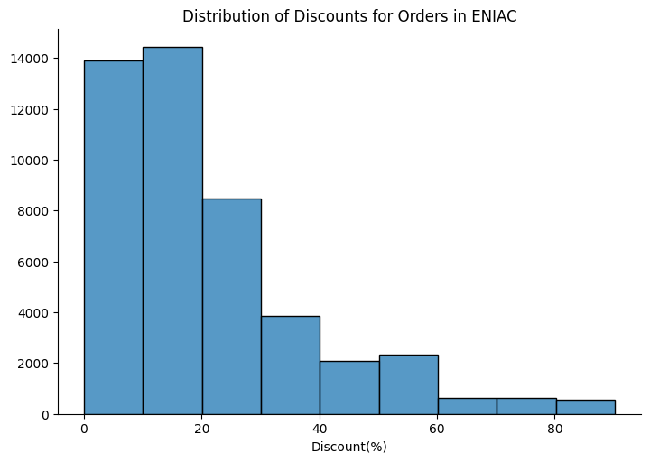
Discount Types
None —-------- 0%
Small —-------- >0% - 10%
Moderate —--- >10% - 25%
Significant—-- >25% - 50%
Heavy –--------- >50% - 75%
Aggressive —-- >75%

Slide 5
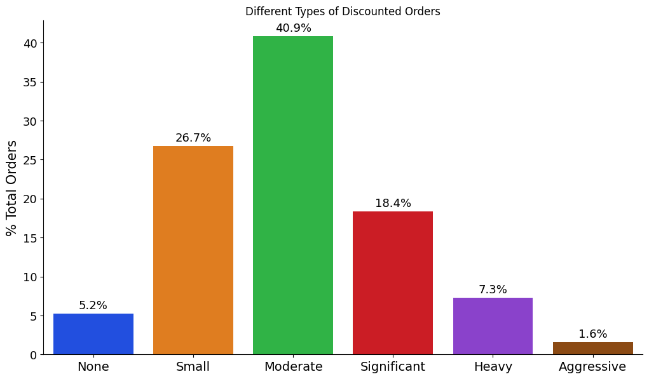
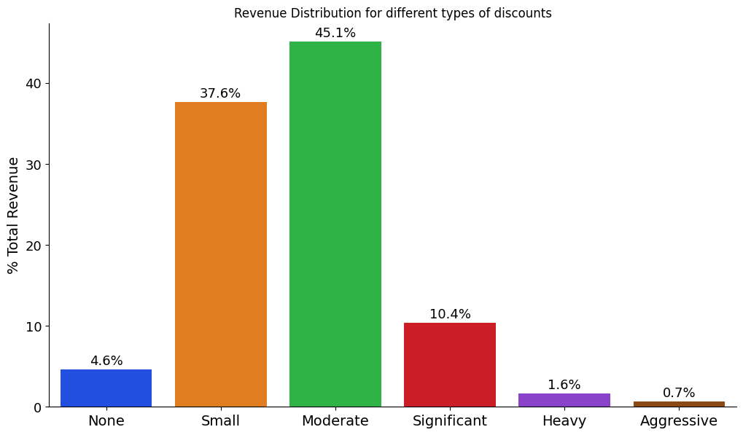
Small —------- 1-10%
Moderate —- 10-25%
Significant—--25-50%
Heavy—------- 50-75%
Aggressive—--75-99%

Slide 6
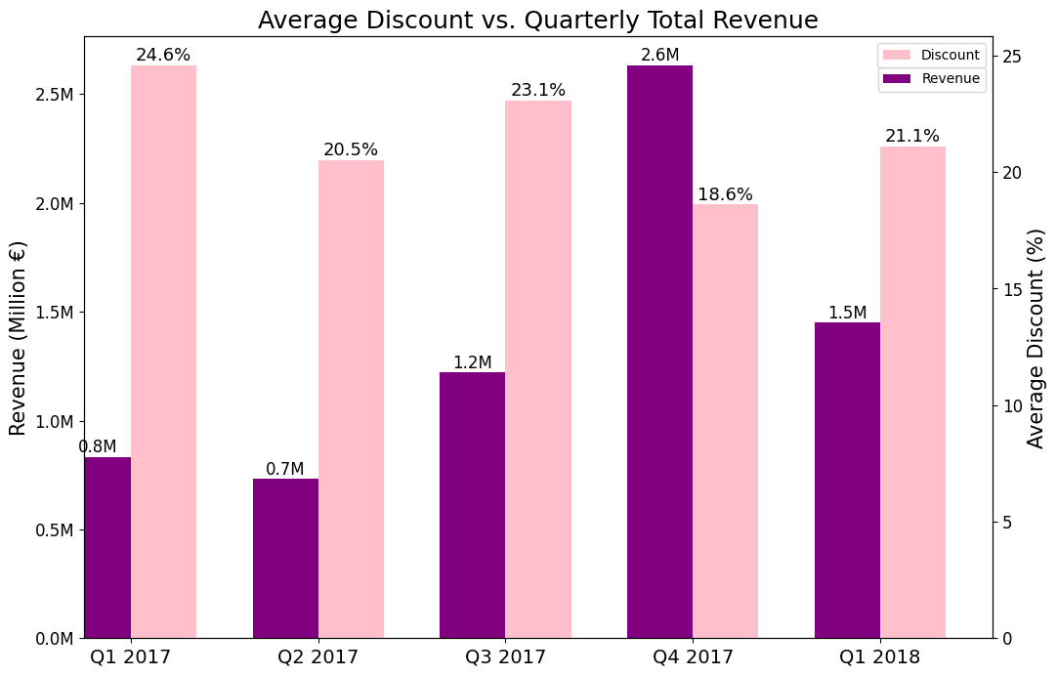

Slide 7
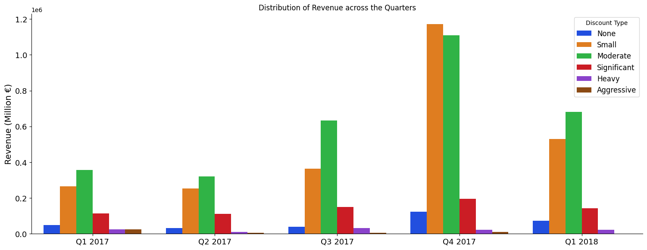
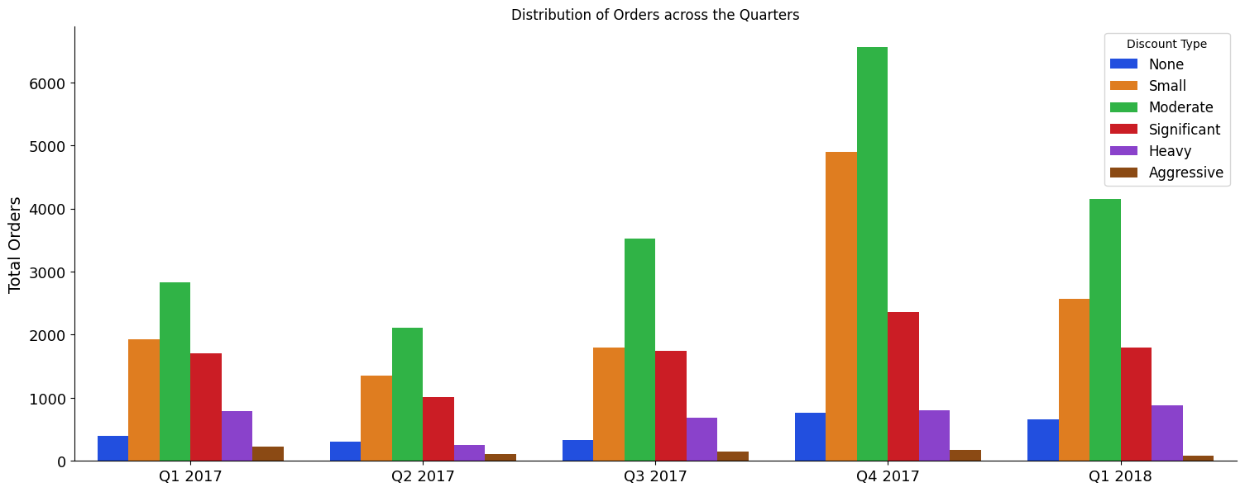

Slide 8
Conclusion
Aggressive Discounts did not affect a positive effect on Revenue or Orders
Recommended range for discounts should not be more than 25% during the early quarters in the year.
Significant discounts can be complemented during the last quarter of the year (btw November and December)

Slide 9
Thank You
for
Listening

Slide 10
Appendix

Slide 11
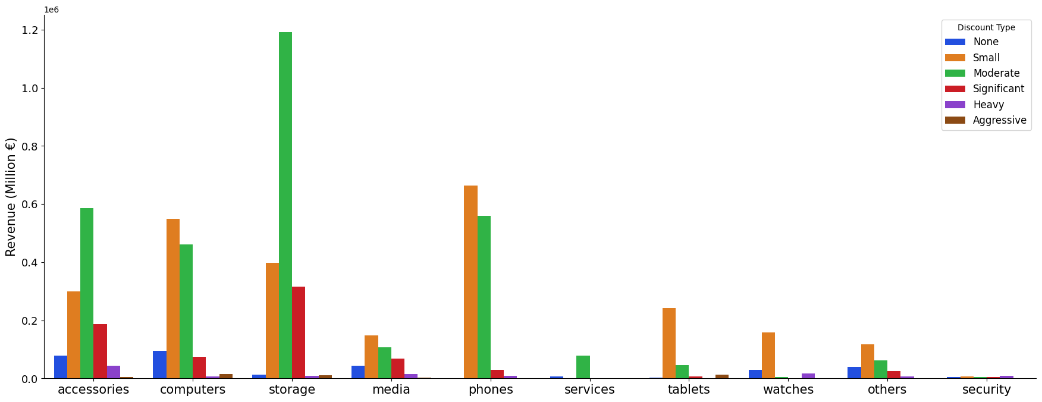
Revenue by Product Category & Discount Types

Slide 12
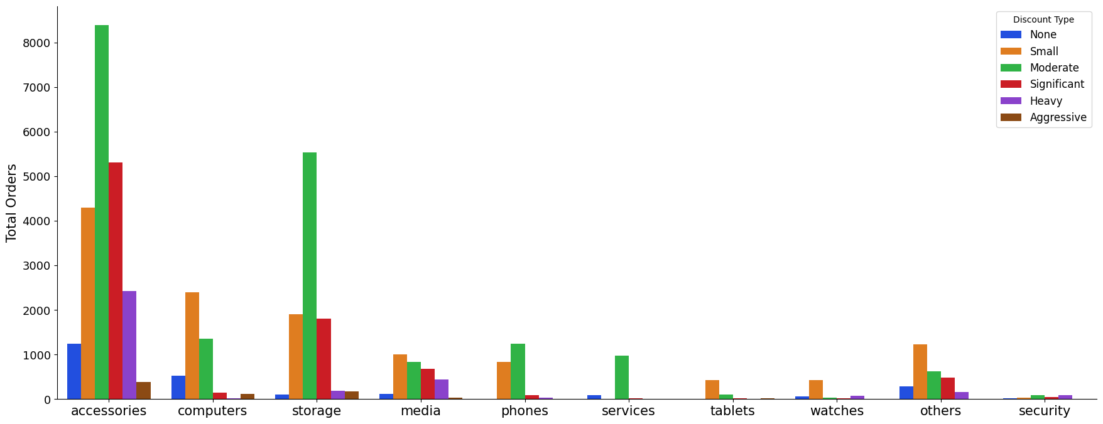
Orders Distribution by Product Category

Slide 13
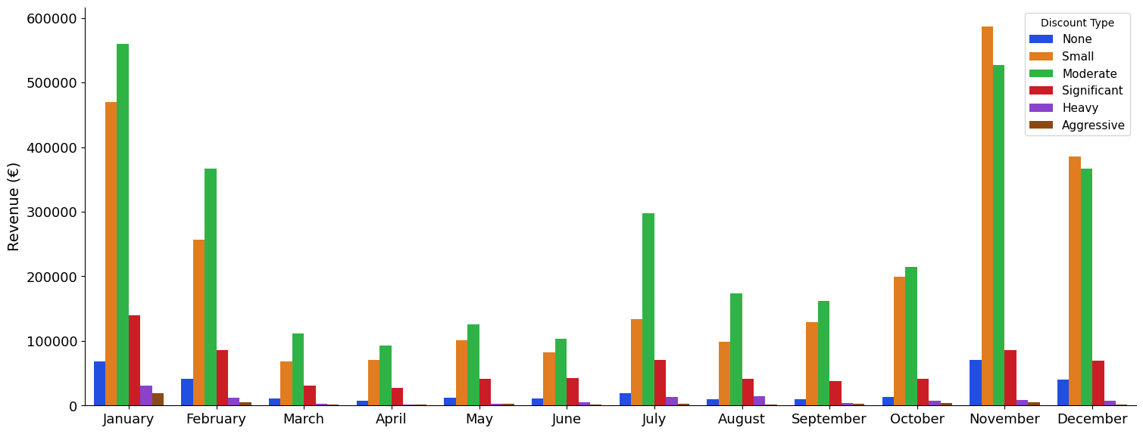
Discount Type vs Monthly Revenue

Slide 14
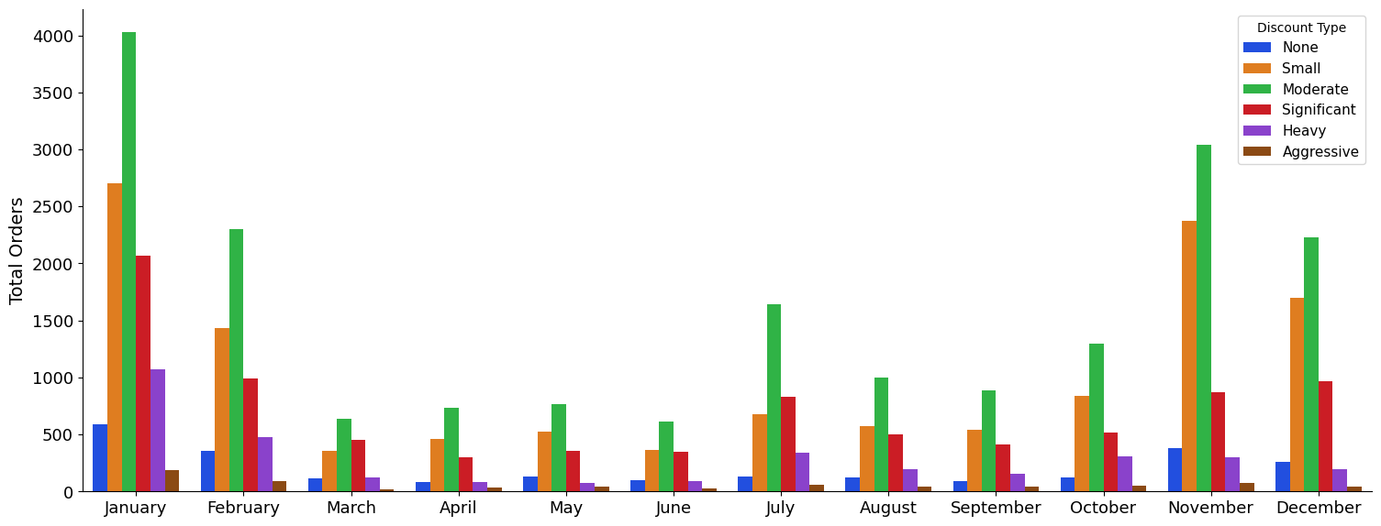
Monthly Orders

Slide 15
Discount Type
vs
Monthly Revenue
Segmented by Product Categories

Slide 16
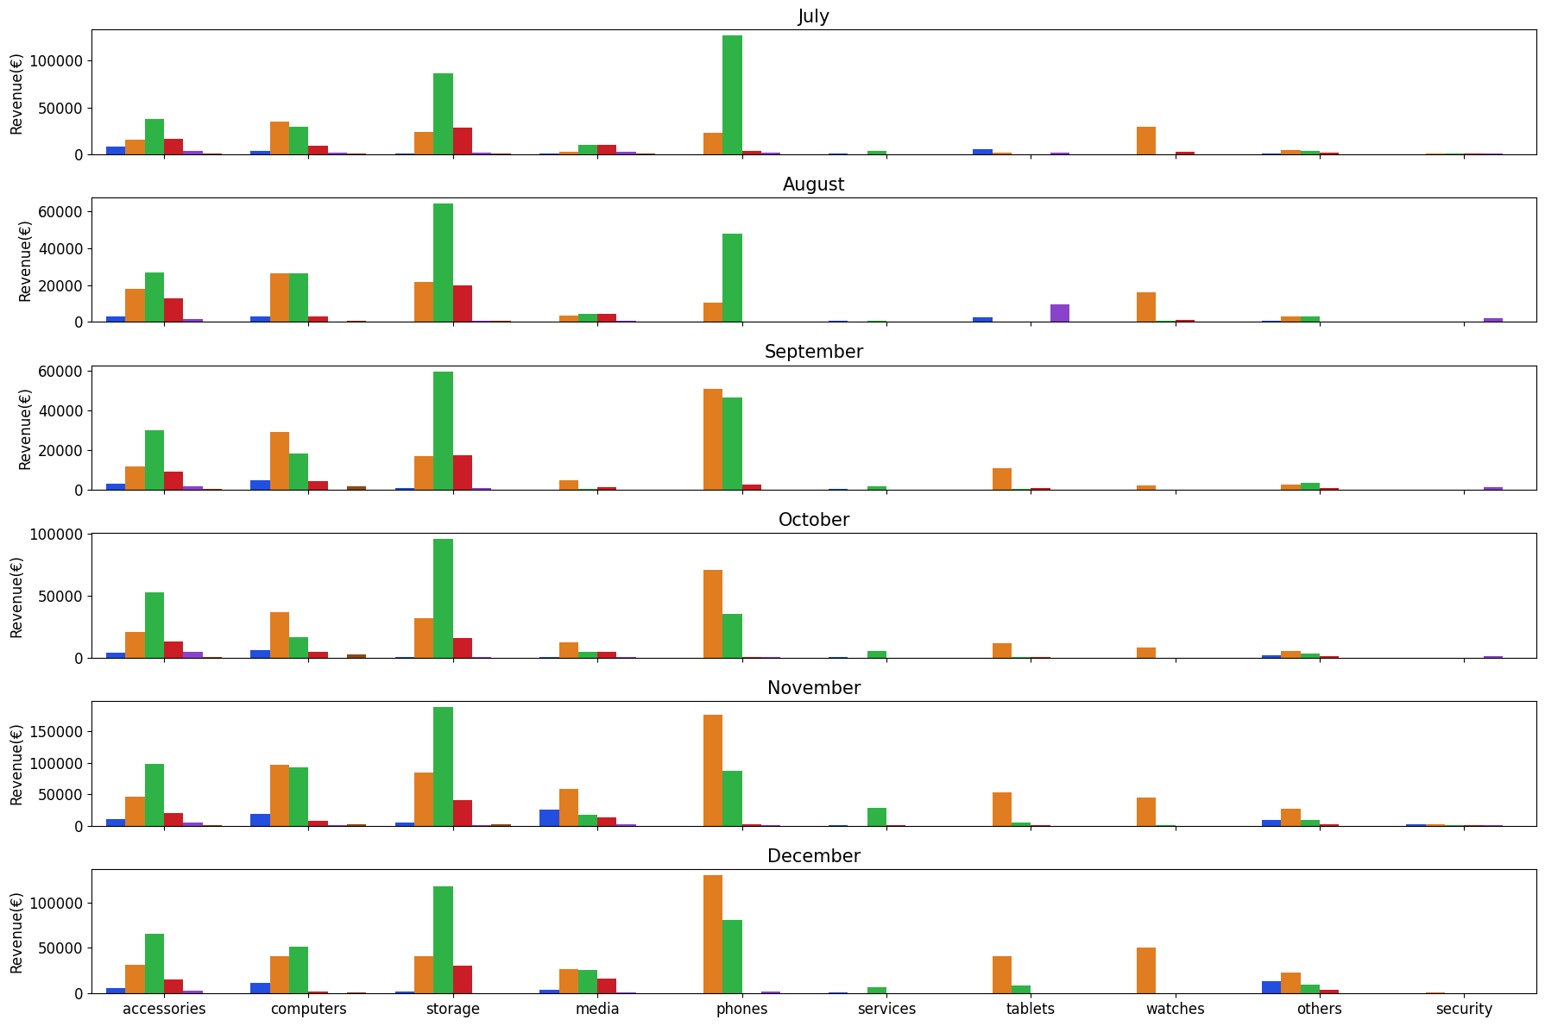

Slide 17
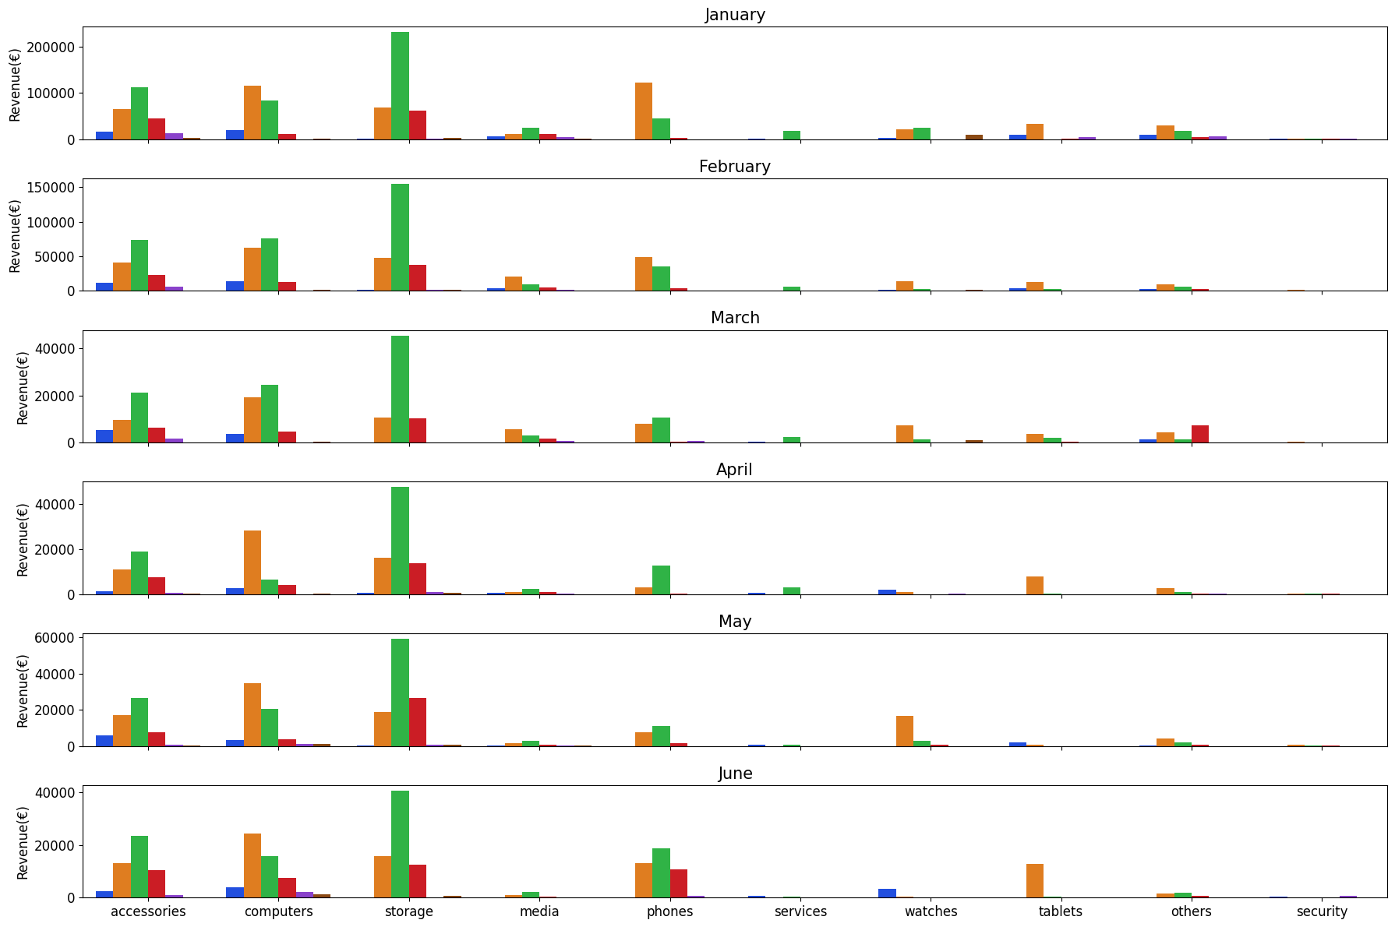

Slide 19
Discount Type
vs
Quarterly Revenue & Orders
Segmented by Product Categories

Slide 20
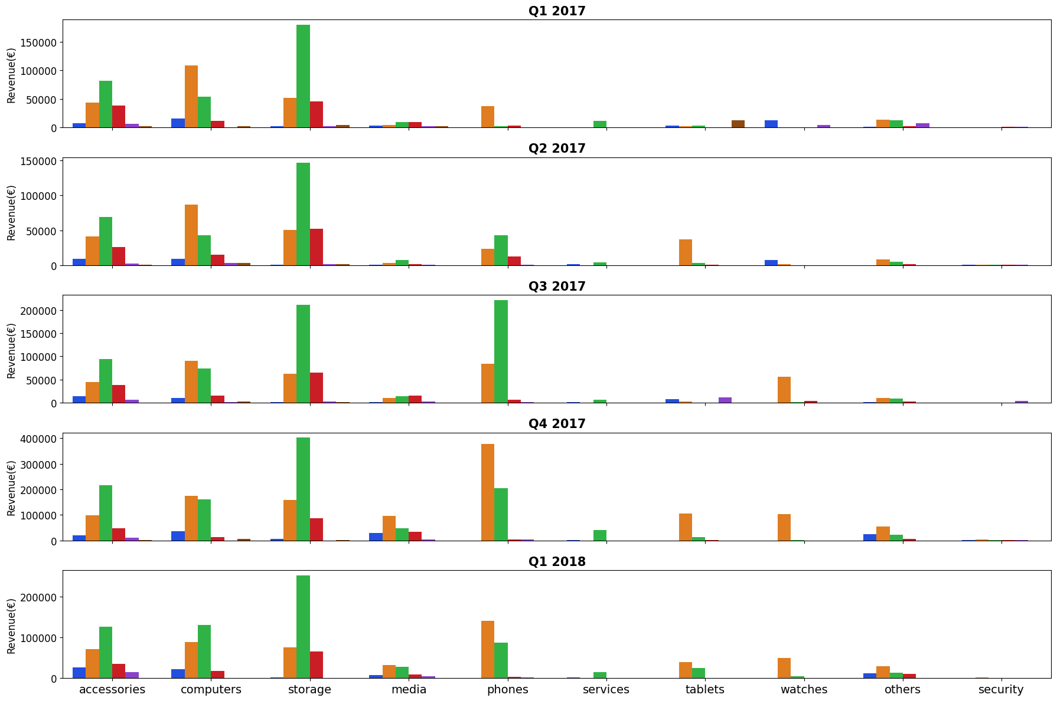

Slide 21
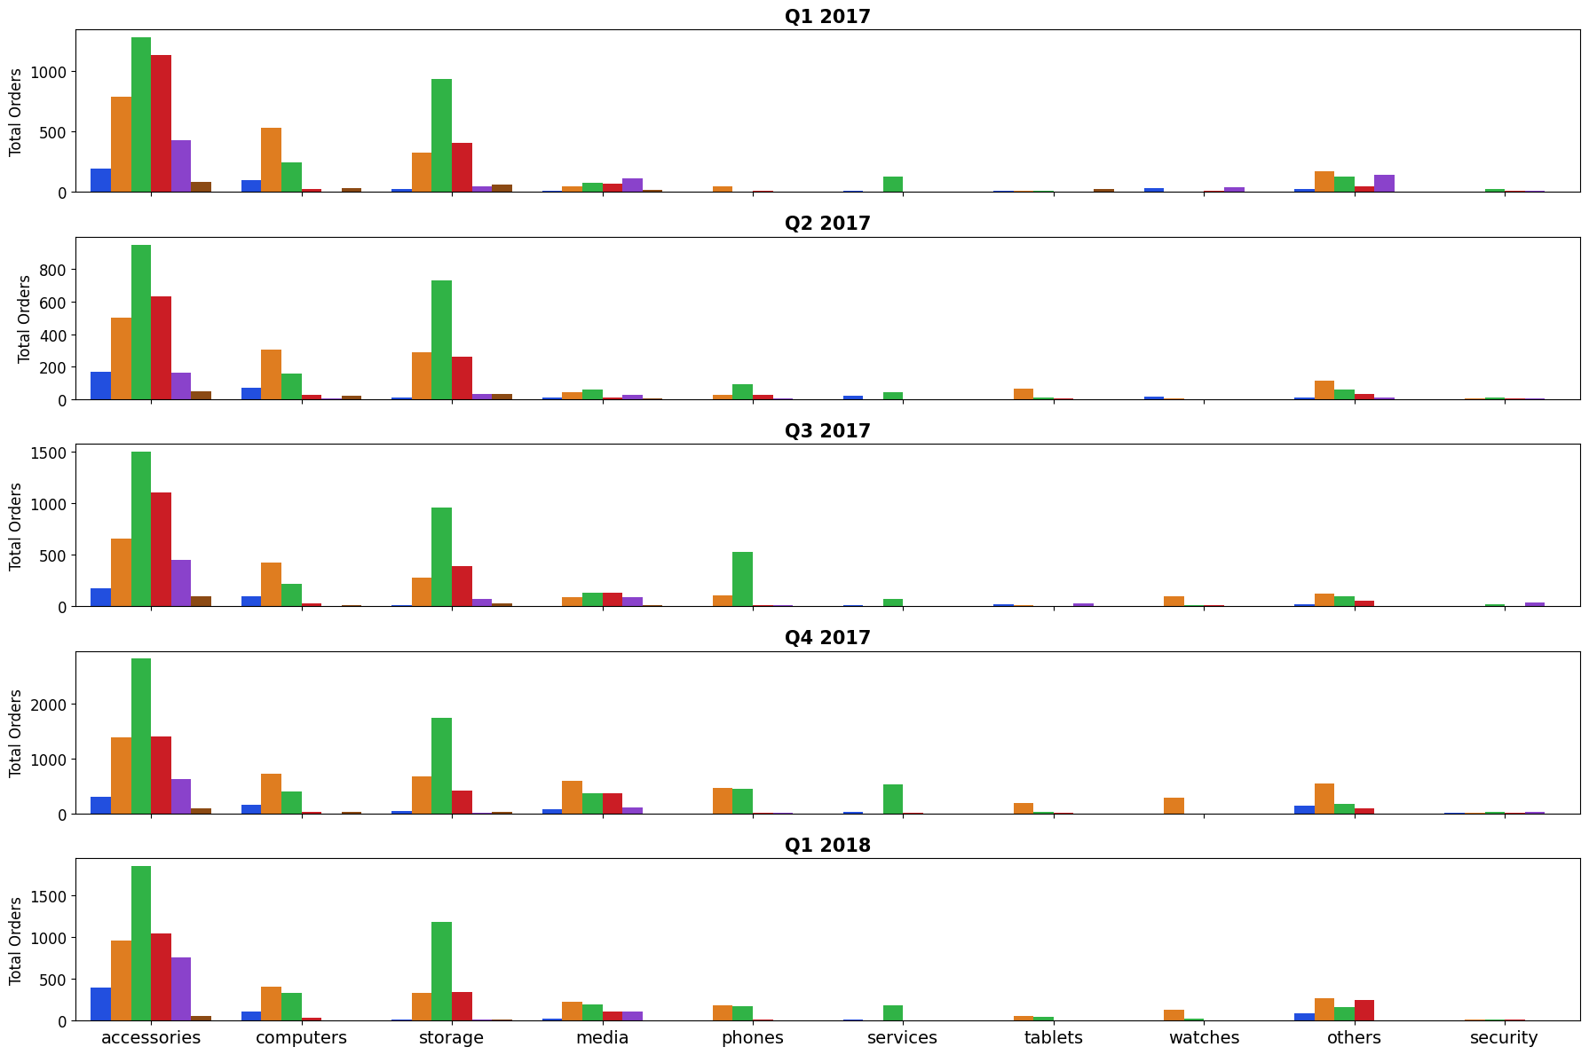

Slide 22
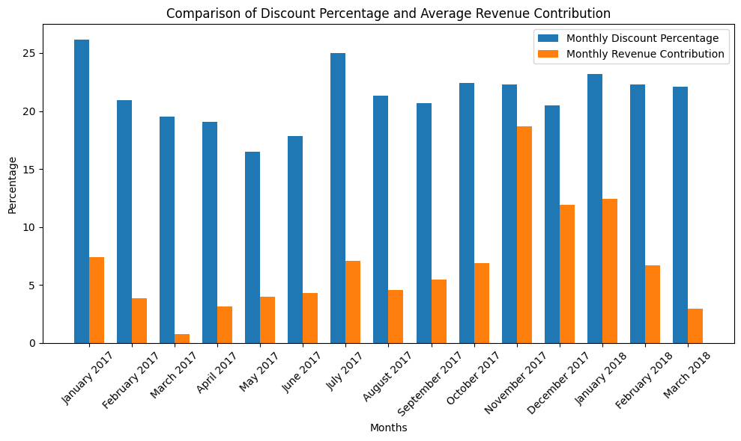

Slide 23
